Slide 1

Principal Component Analysis (PCA) on the Iris Data Set
Author: Keaton LaBorde
Date: 12/10/2024

Slide 2
Introduction to PCA
What is PCA?
A technique for dimensionality reduction
Transforms data into principal components
Retains as much variability as possible
Why Use PCA?
Reduce dimensionality in correlated datasets
Improve efficiency, reduce multicollinearity, enhance interpretability

Slide 3
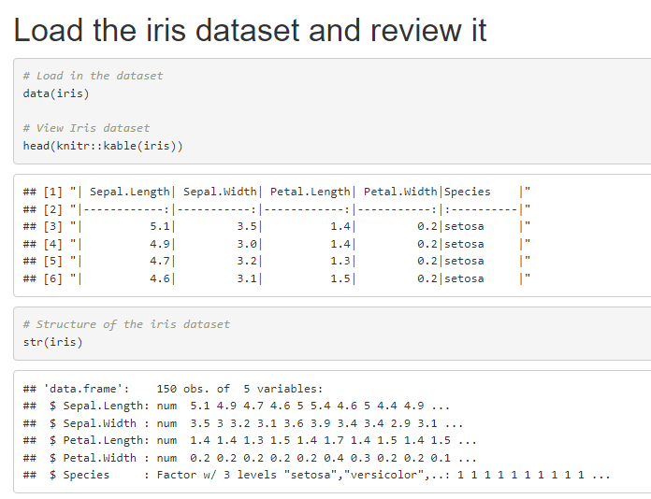
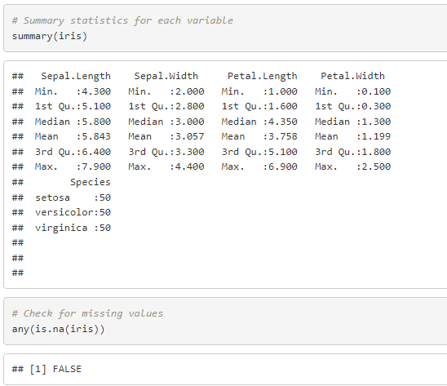
Iris Dataset Overview
Dataset Summary:
Observations: 150
Features: 4
Species: 3
Basic Data Check:
No missing values
Summary statistics and structure

Slide 4
Exploratory Data Analysis
Correlation Check:
Scatter plots to visualize pairwise relationships
Correlation matrix to quantify relationships
Objective: Identify correlated features to guide PCA

Slide 5
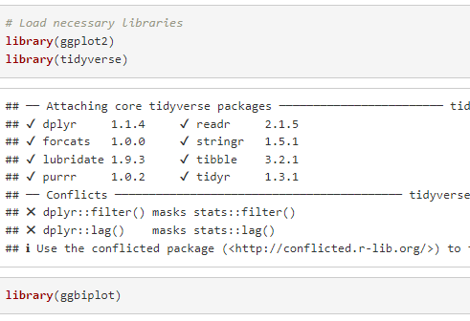
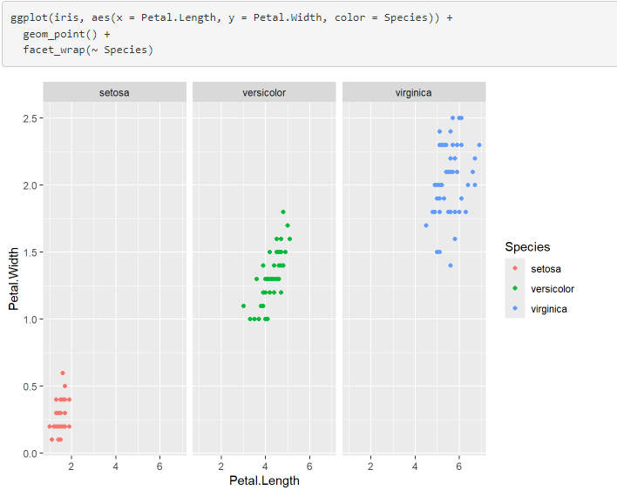
Pairwise Scatter Plots
Scatter Plots:
Visualize the relationship between pairs of features
Explore how features correlate for different species
Observation: Petal Length and Petal Width are strongly correlated

Slide 6
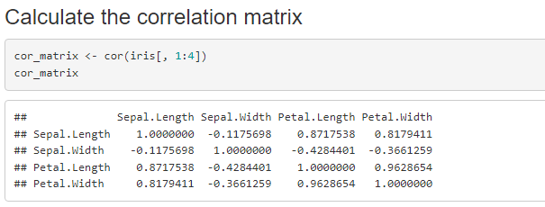
Correlation Matrix
Matrix of correlations between features:
High correlation between Petal Length and Petal Width
Lower correlations between Sepal Length and Sepal Width
PCA Objective: Reduce redundant features
Notes:
Cor inputs a dataframe and outputs a dataframe or matrix

Slide 7
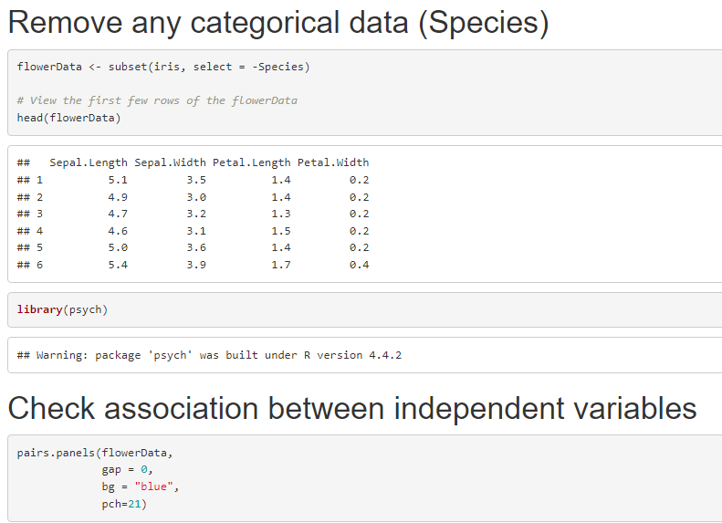
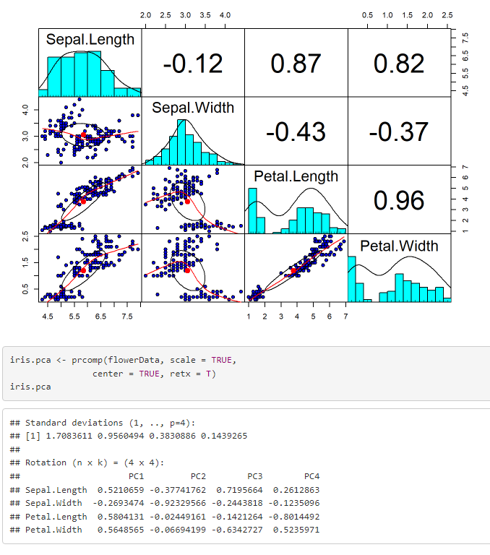
Principal Component Analysis (PCA)
PCA Basics:
Eigenvalues and eigenvectors represent directions of maximum variance
Principal Components (PCs) are uncorrelated
First Two Components:
PC1 explains 72.96% of the variance
PC2 explains 22.85% of the variance
Together: 95.81% of variance explained
Notes:
Pairs.panels function inputs a data frame or matrix and outputs a scatter plot matrix. Pch is the plot character (defaults to 20 which is a ‘.’). Prcomp inputs matrix or dataframe and outputs a list with a class prcomp. Scale is a logical value indicating whether the variables should be scaled to have unit variance before the analysis takes place. The default is FALSE. Center is also a logical value indicating whether the variables should be shifted to be zero centered. Alternately, a vector of length equal the number of columns of x can be supplied. Retx is a logical value indicating whether the rotated variables should be returned.

Slide 8
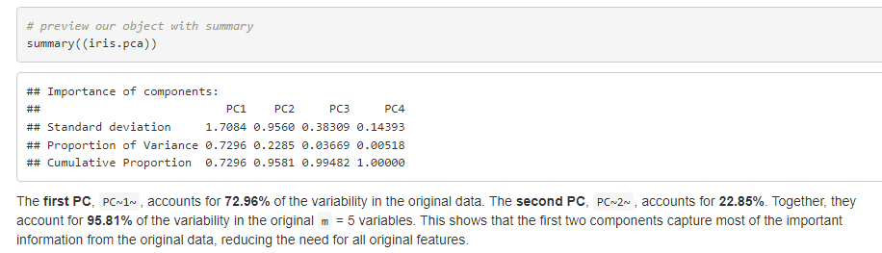
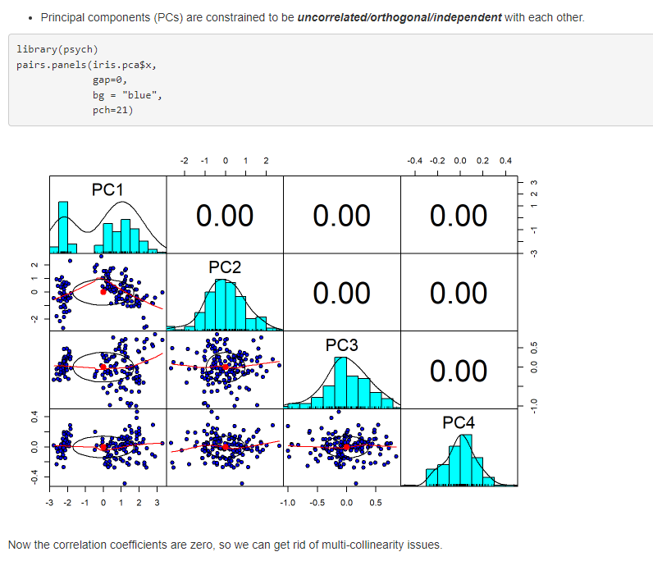
PCA Results
PCA Object Summary:
Standard deviations (eigenvalues)
Center (means subtracted)
Rotation (eigenvectors)
First Two PCs:
PC1: Key driver of variability in petal-related features
PC2: Captures additional variance, especially between species

Slide 9
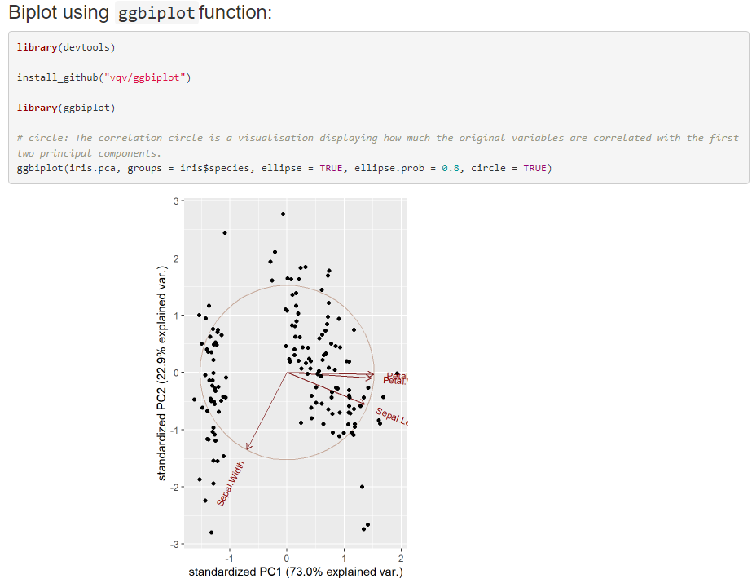
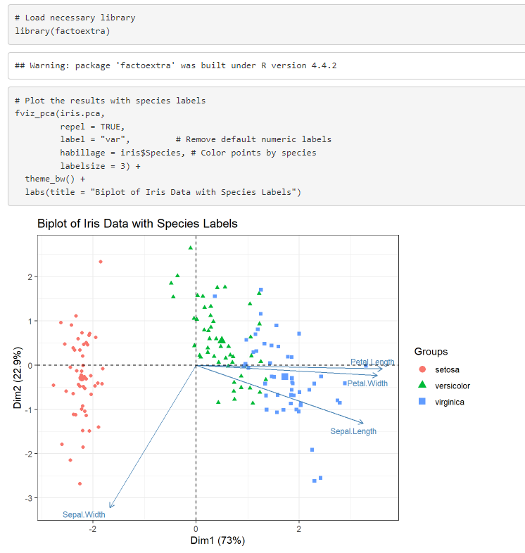
PCA Visualization
Biplot:
Principal components plotted with variables and observations
Clear separation of species
Setosa is distinct, Versicolor and Virginica are closer
Interpretation:
Vector angles indicate correlation between variables (e.g., Petal Length & Petal Width)
Notes:
Fviz_pca inputs a dataframe or matrix and outputs a ggplot. Repel is a boolean, whether to use ggrepel to avoid overplotting text labels or not. Habillage is optional and groups the variables by color in this case species.

Slide 10
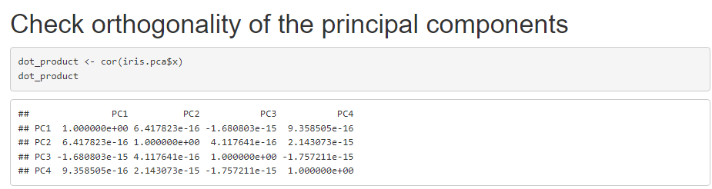
Orthogonality of Principal Components
Property of PCA: PCs are uncorrelated (orthogonal)
Dot Product Check:
Confirming orthogonality by computing the dot product between principal components
PCs are independent

Slide 11
PCA Biplot cont.
Interpretation:
Vectors represent original features
Small angle = strong correlation between features
Points represent observations, colors represent species
The results show close to zero off the diagonal
Iris.pca is truly orthogonal
Captures independent and non-redundant information

Slide 12
Advantages of PCA
Key Benefits:
Reduces dimensionality
Resolves multicollinearity
Facilitates data visualization
Enhances computational efficiency

Slide 13
Disadvantages of PCA
Key Limitations:
Loss of interpretability (PCs are linear combinations)
Assumes linearity, which may not apply to all data
Sensitive to scaling and outliers

Slide 14

Applications of PCA
Machine Learning: Reduce features for better model performance and prevent overfitting
Image Processing: Reduce image size while retaining important features
Finance: Dimensionality reduction for portfolio optimization and risk management

Slide 15
Conclusion
Summary:
PCA effectively reduced dimensionality of the Iris dataset
Retained 95.81% of the variability in 2 principal components
Clear separation of species, aiding in classification
Future Considerations:
Use PCA for feature reduction in machine learning models

Slide 16
References
Jolliffe, I. T. (2002). Principal Component Analysis. Springer Series in Statistics.
Iglewicz, B., & Hoaglin, D. C. (1993). How to detect and handle outliers. Sage.

